Slide 1

League Website
Peter Ramos

Slide 2



Agenda
Desktop View
Mobile View

Slide 3

Topic one
Speed Up/ HyperText Transfer Protocol Secure

Slide 4
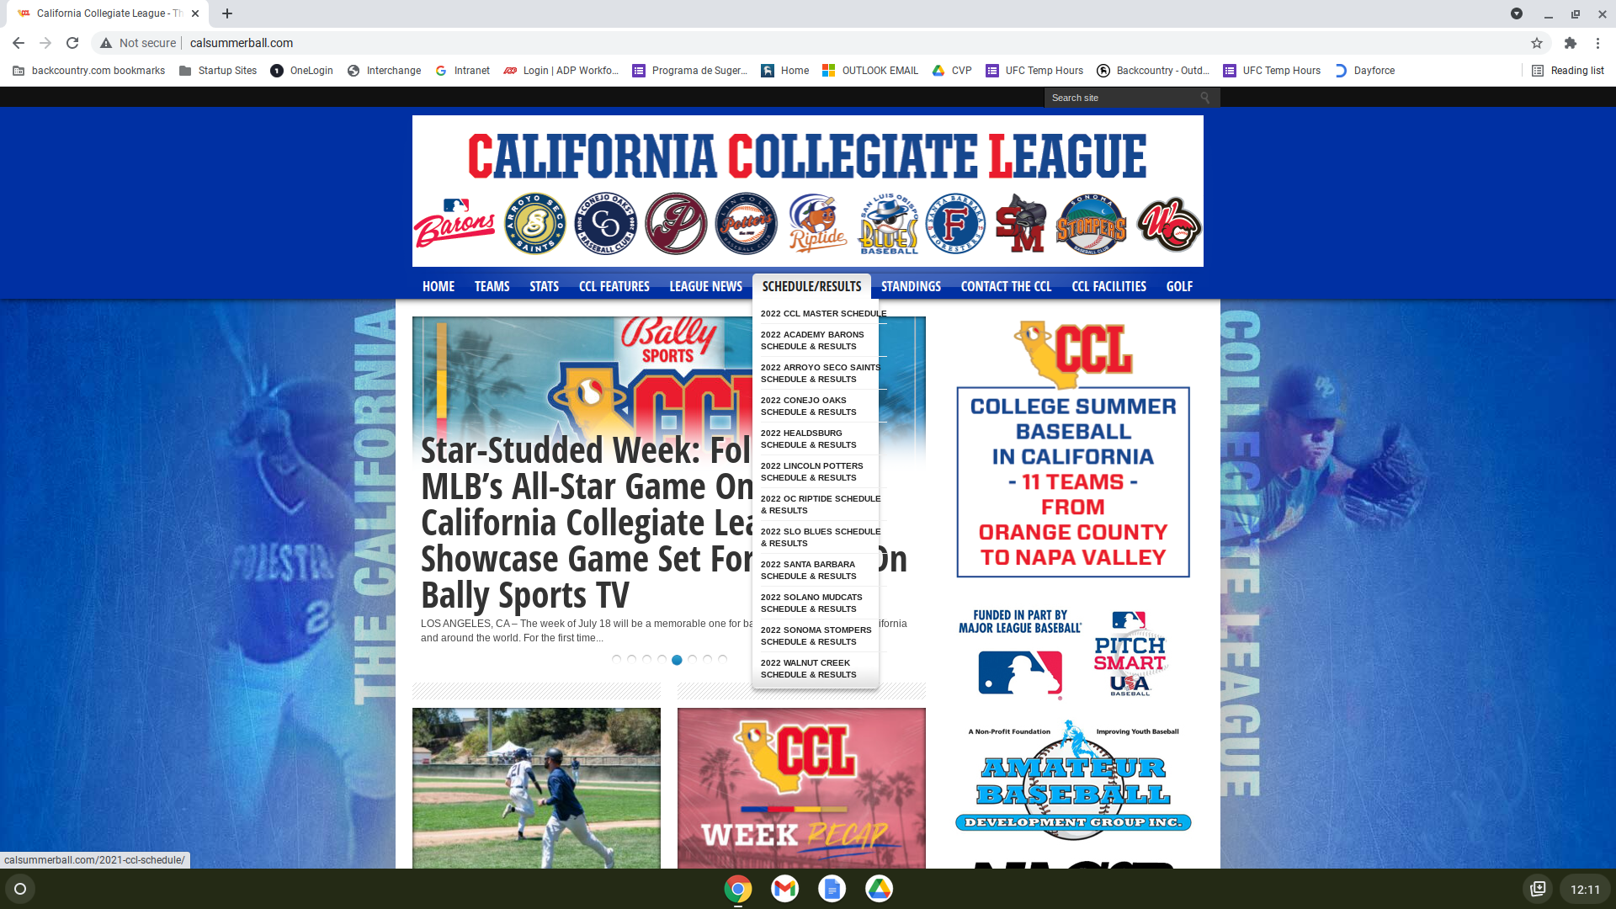
Not secure | calsummerball.com
Pros for HTTPS
Visitor has more confident to visit the website
Website is encrypt
Website is verified
Speeding up the Website
Delete all the cache files and unnecessary plugins

Slide 5
Topic two
Desktop view inconsistent look

Slide 6
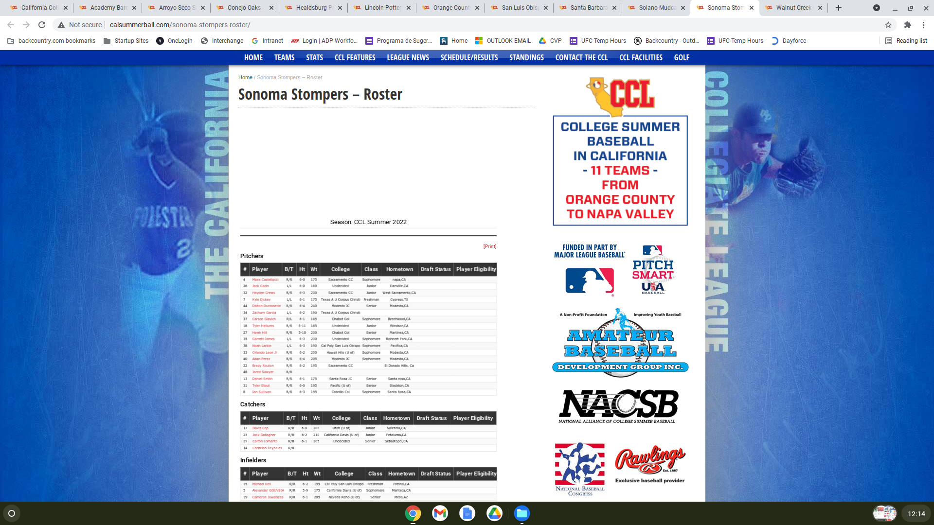
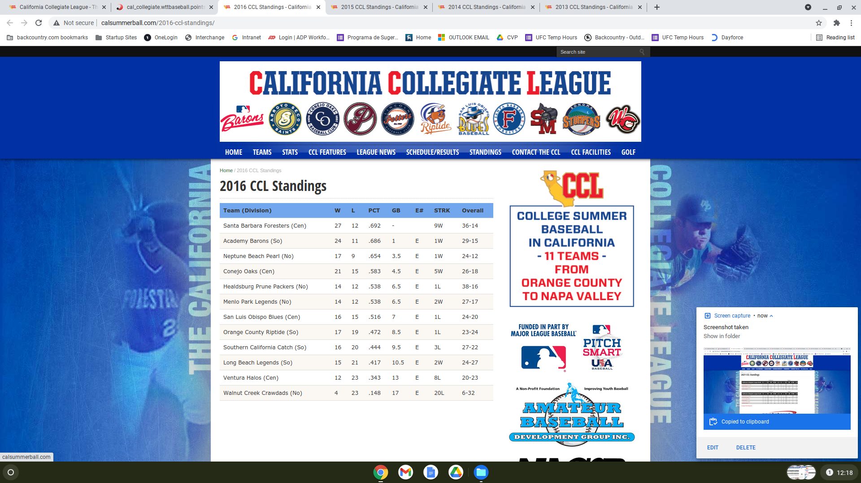
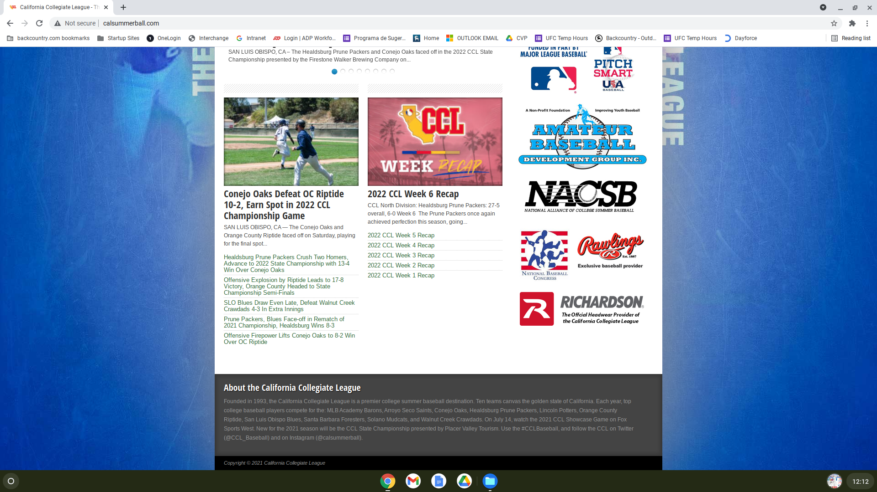
Desktop view problem 1
Top left
Unnecessary gap on the top of Roster
Top right
Align the drop down
Lower left
Unnecessary gap on the bottom of standing
Lower Right
Change the footer, improvent, change font or style

Slide 7
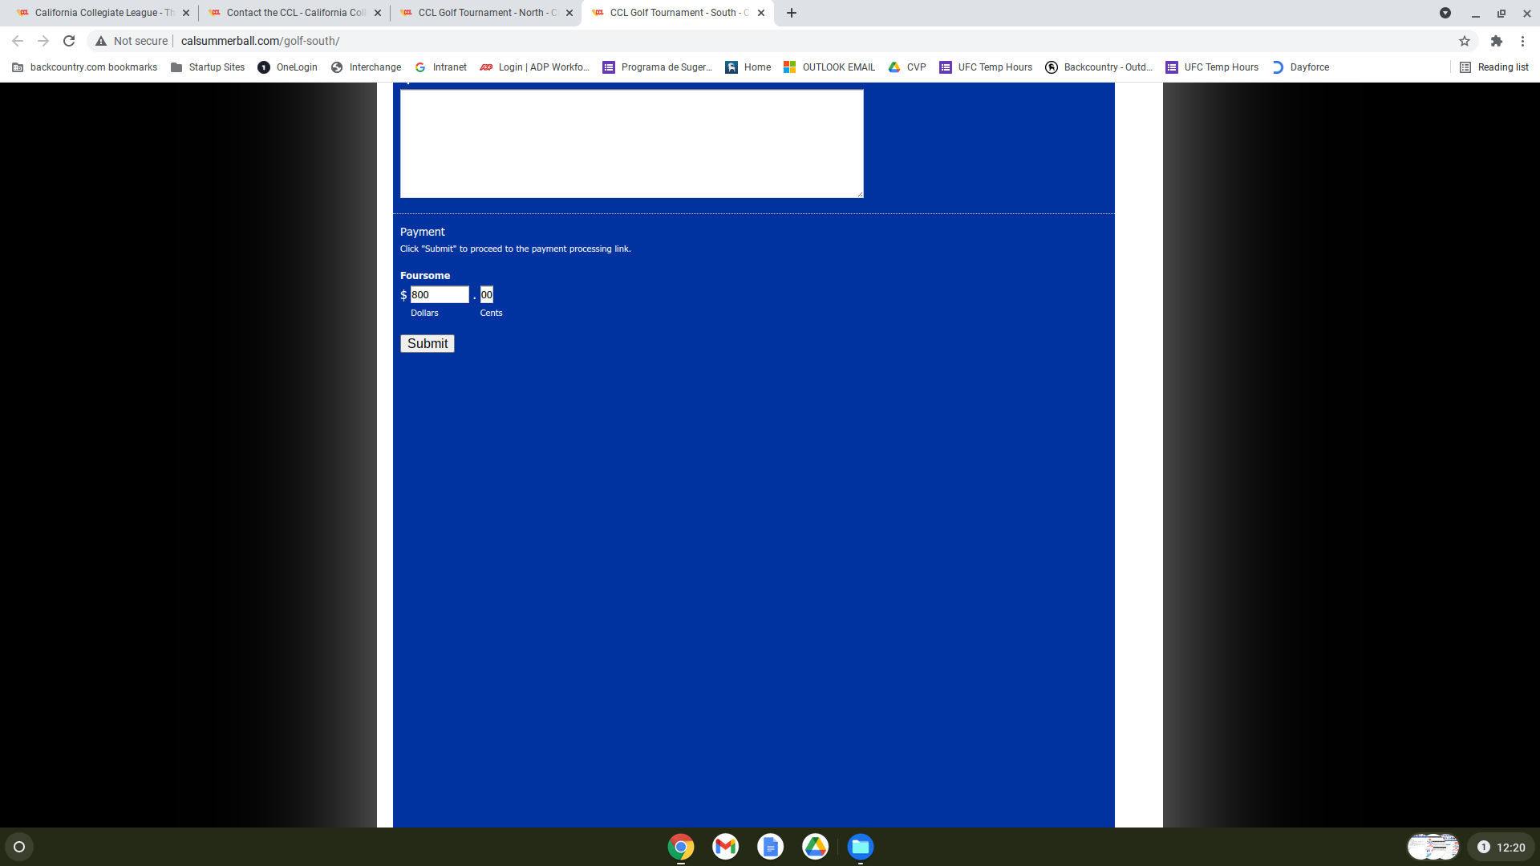
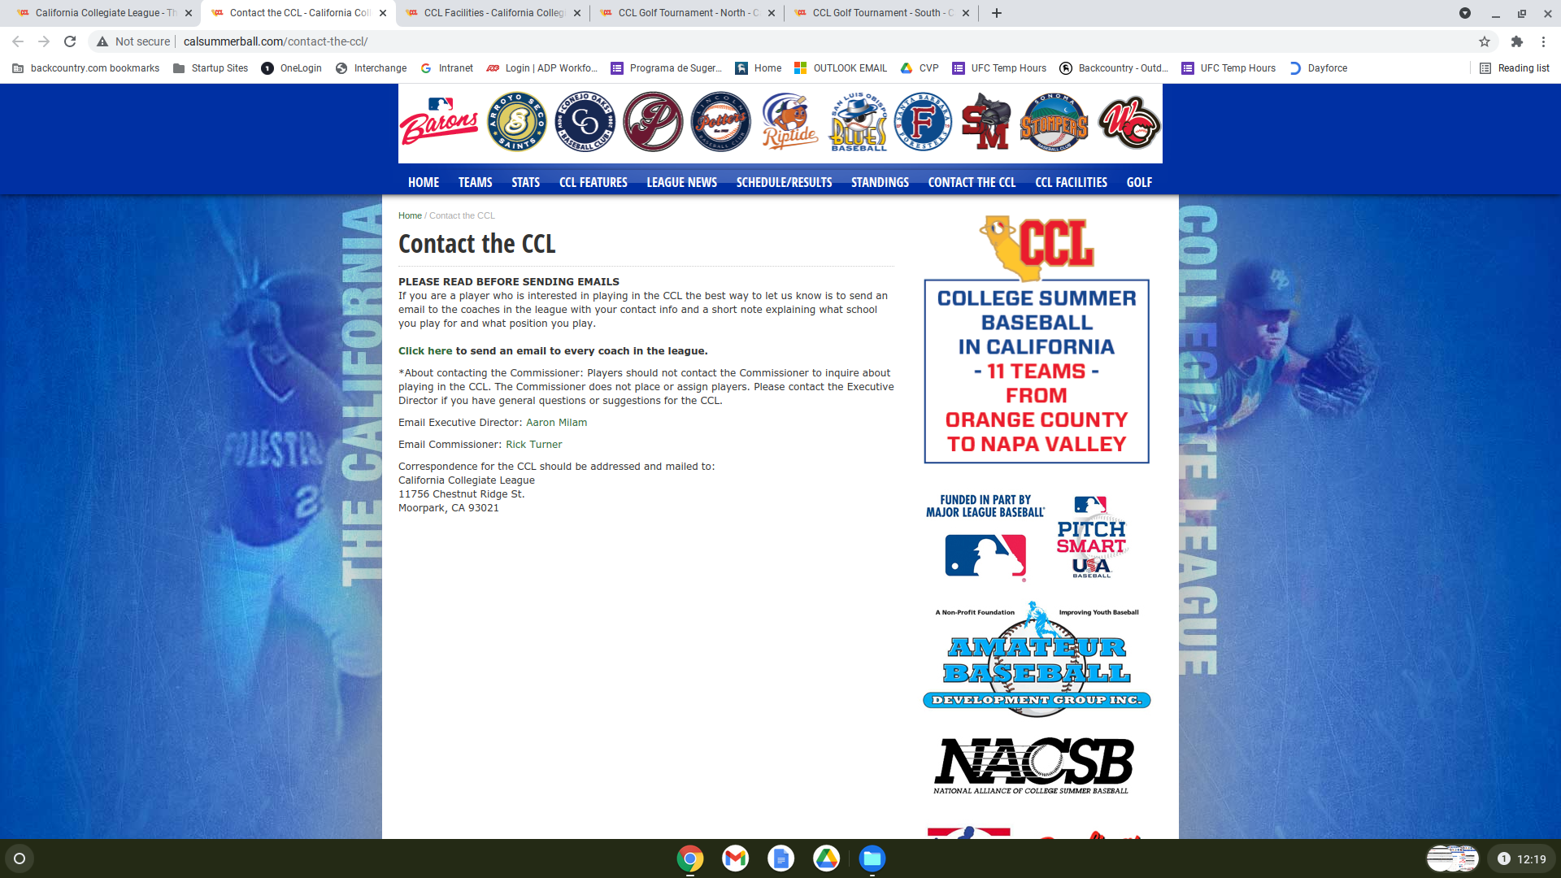
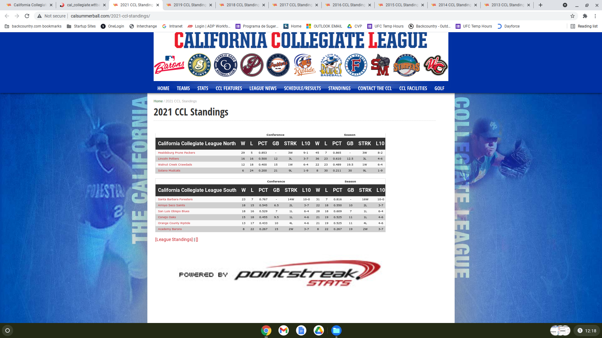
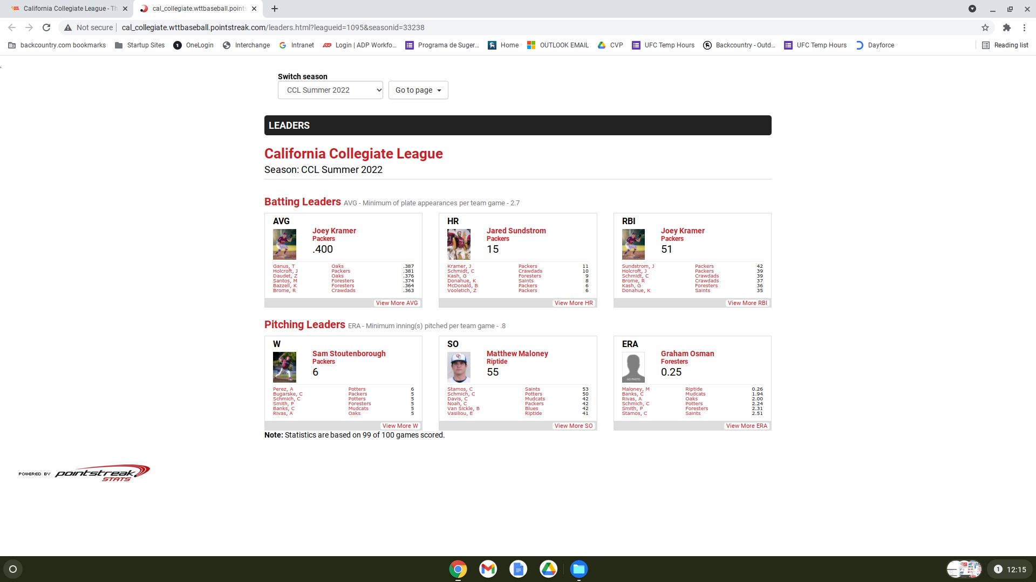
Desktop view problem 2
Top left
Unnecessary gap on the bottom
Top right
Unnecessary gap on the bottom
Lower left
Inconsistent style from the other standings page
Lower Right
Is this our website? Or just api fetch from Pointstreak.com

Slide 8
Topic three
Mobile view inconsistent look

Slide 9
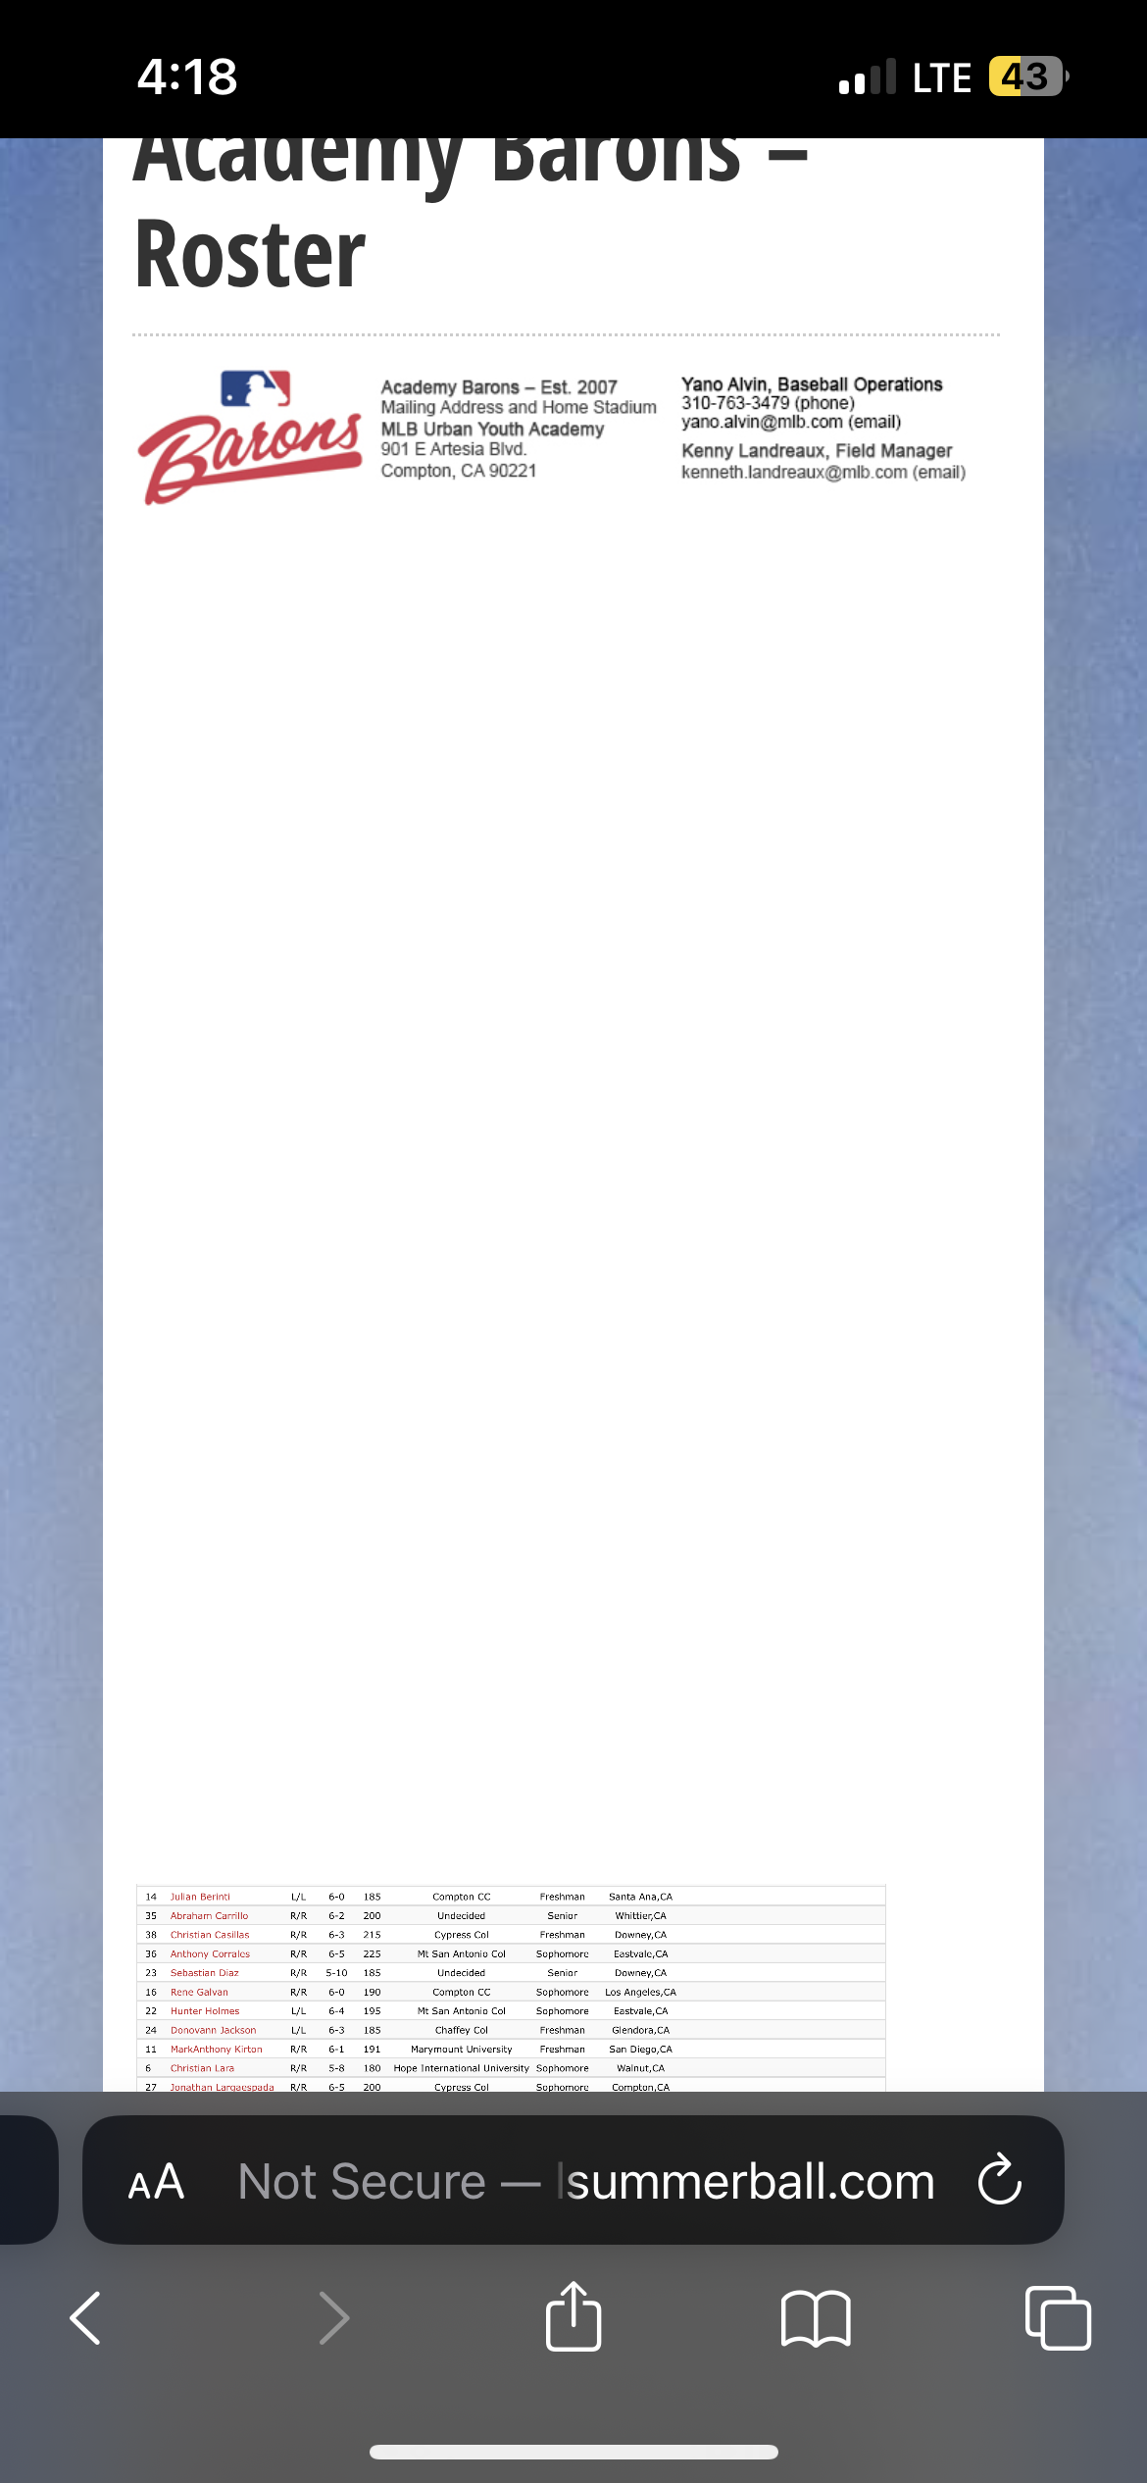
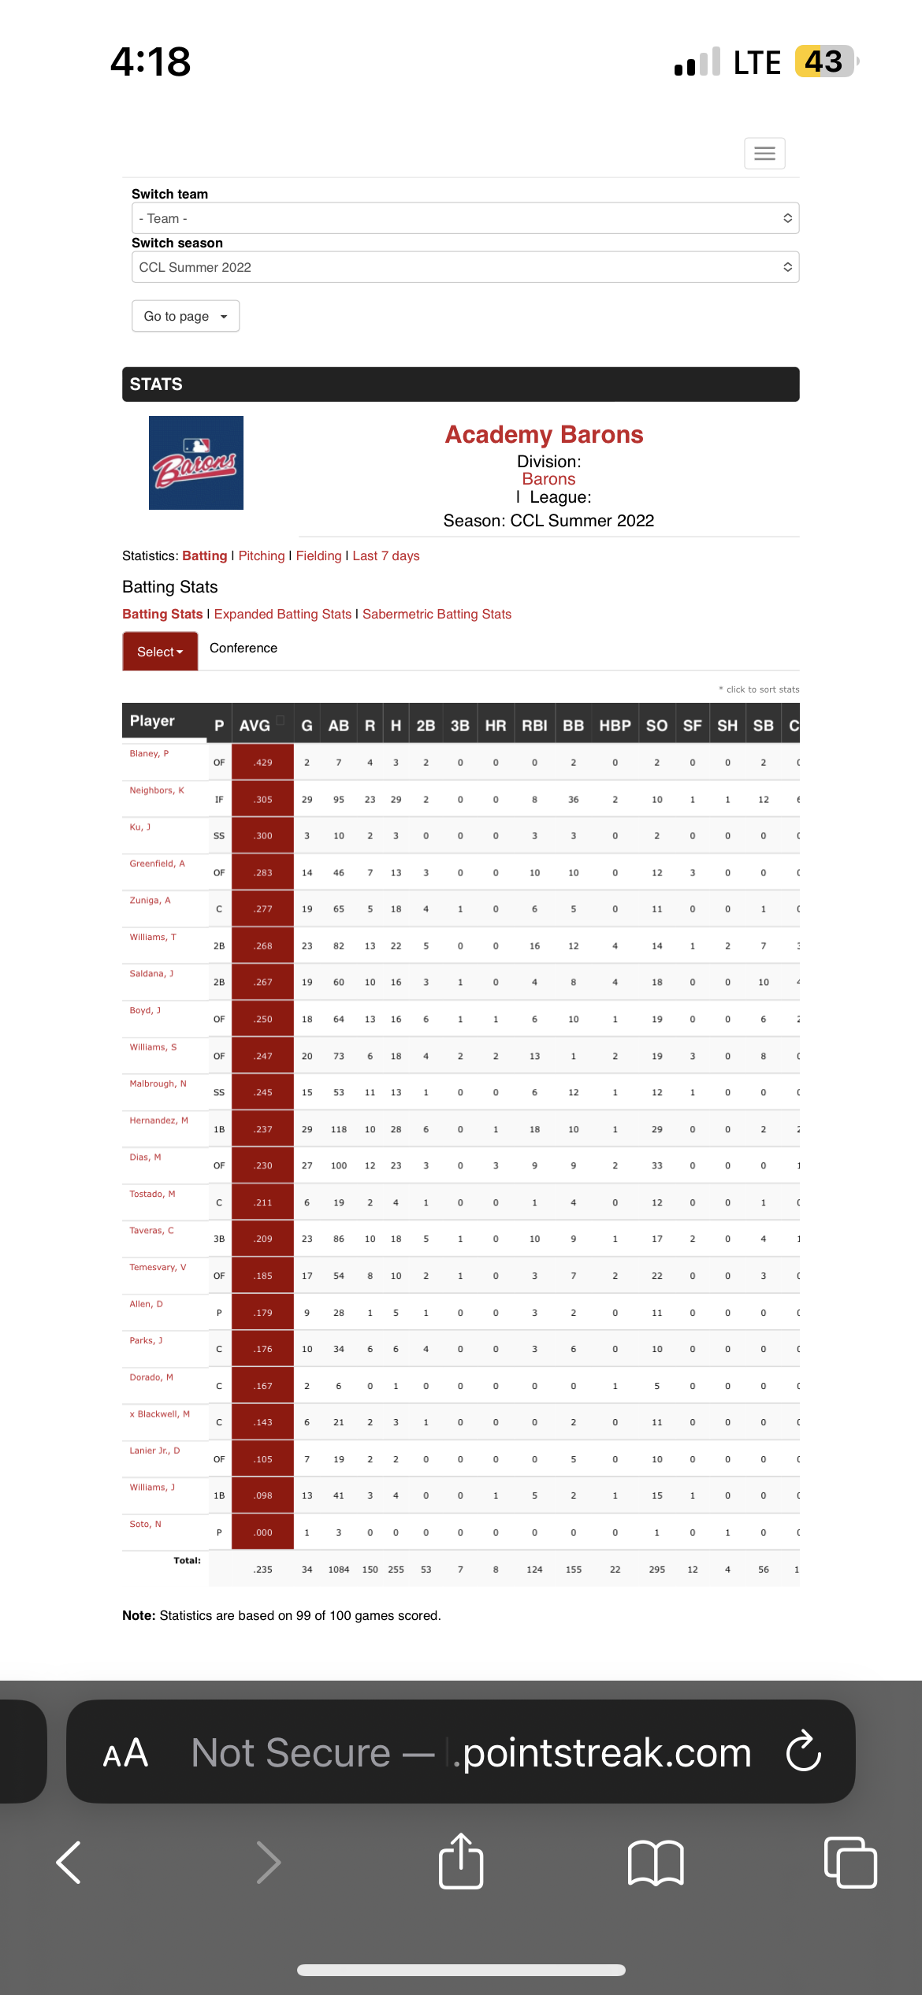
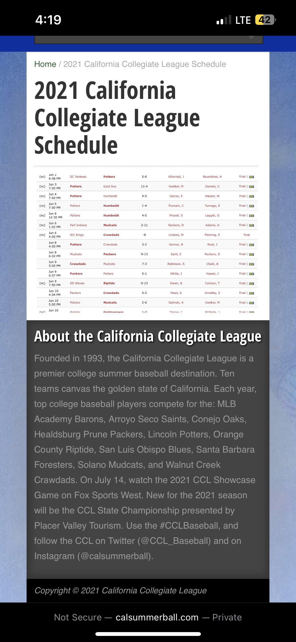
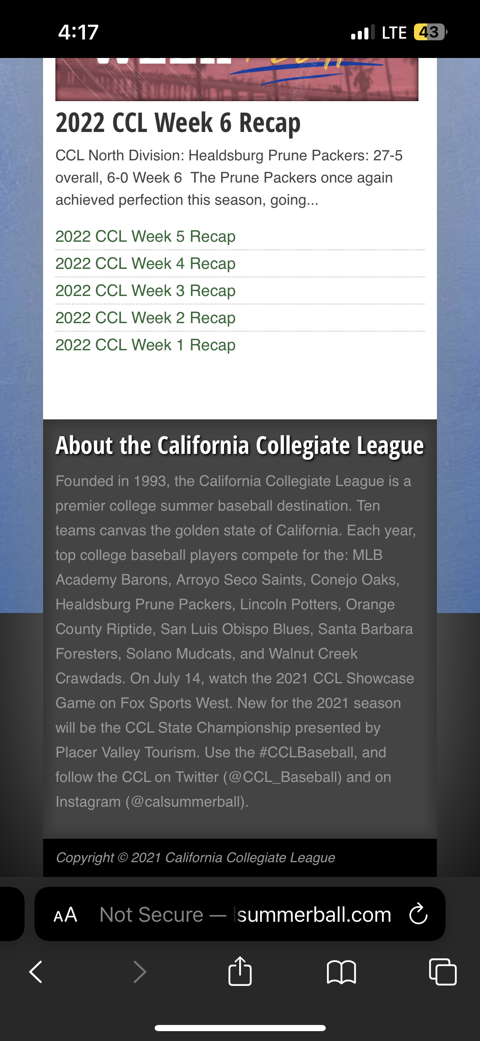
Mobile view problem 1
Top left
Unnecessary gap on the bottom
Top right
Same with the desktop view is this our website or pulled from Pointstreak.com
Lower left
Fonts and style are too small hard to read
Lower Right
Same with the desktop view this should be reevaluate

Slide 10
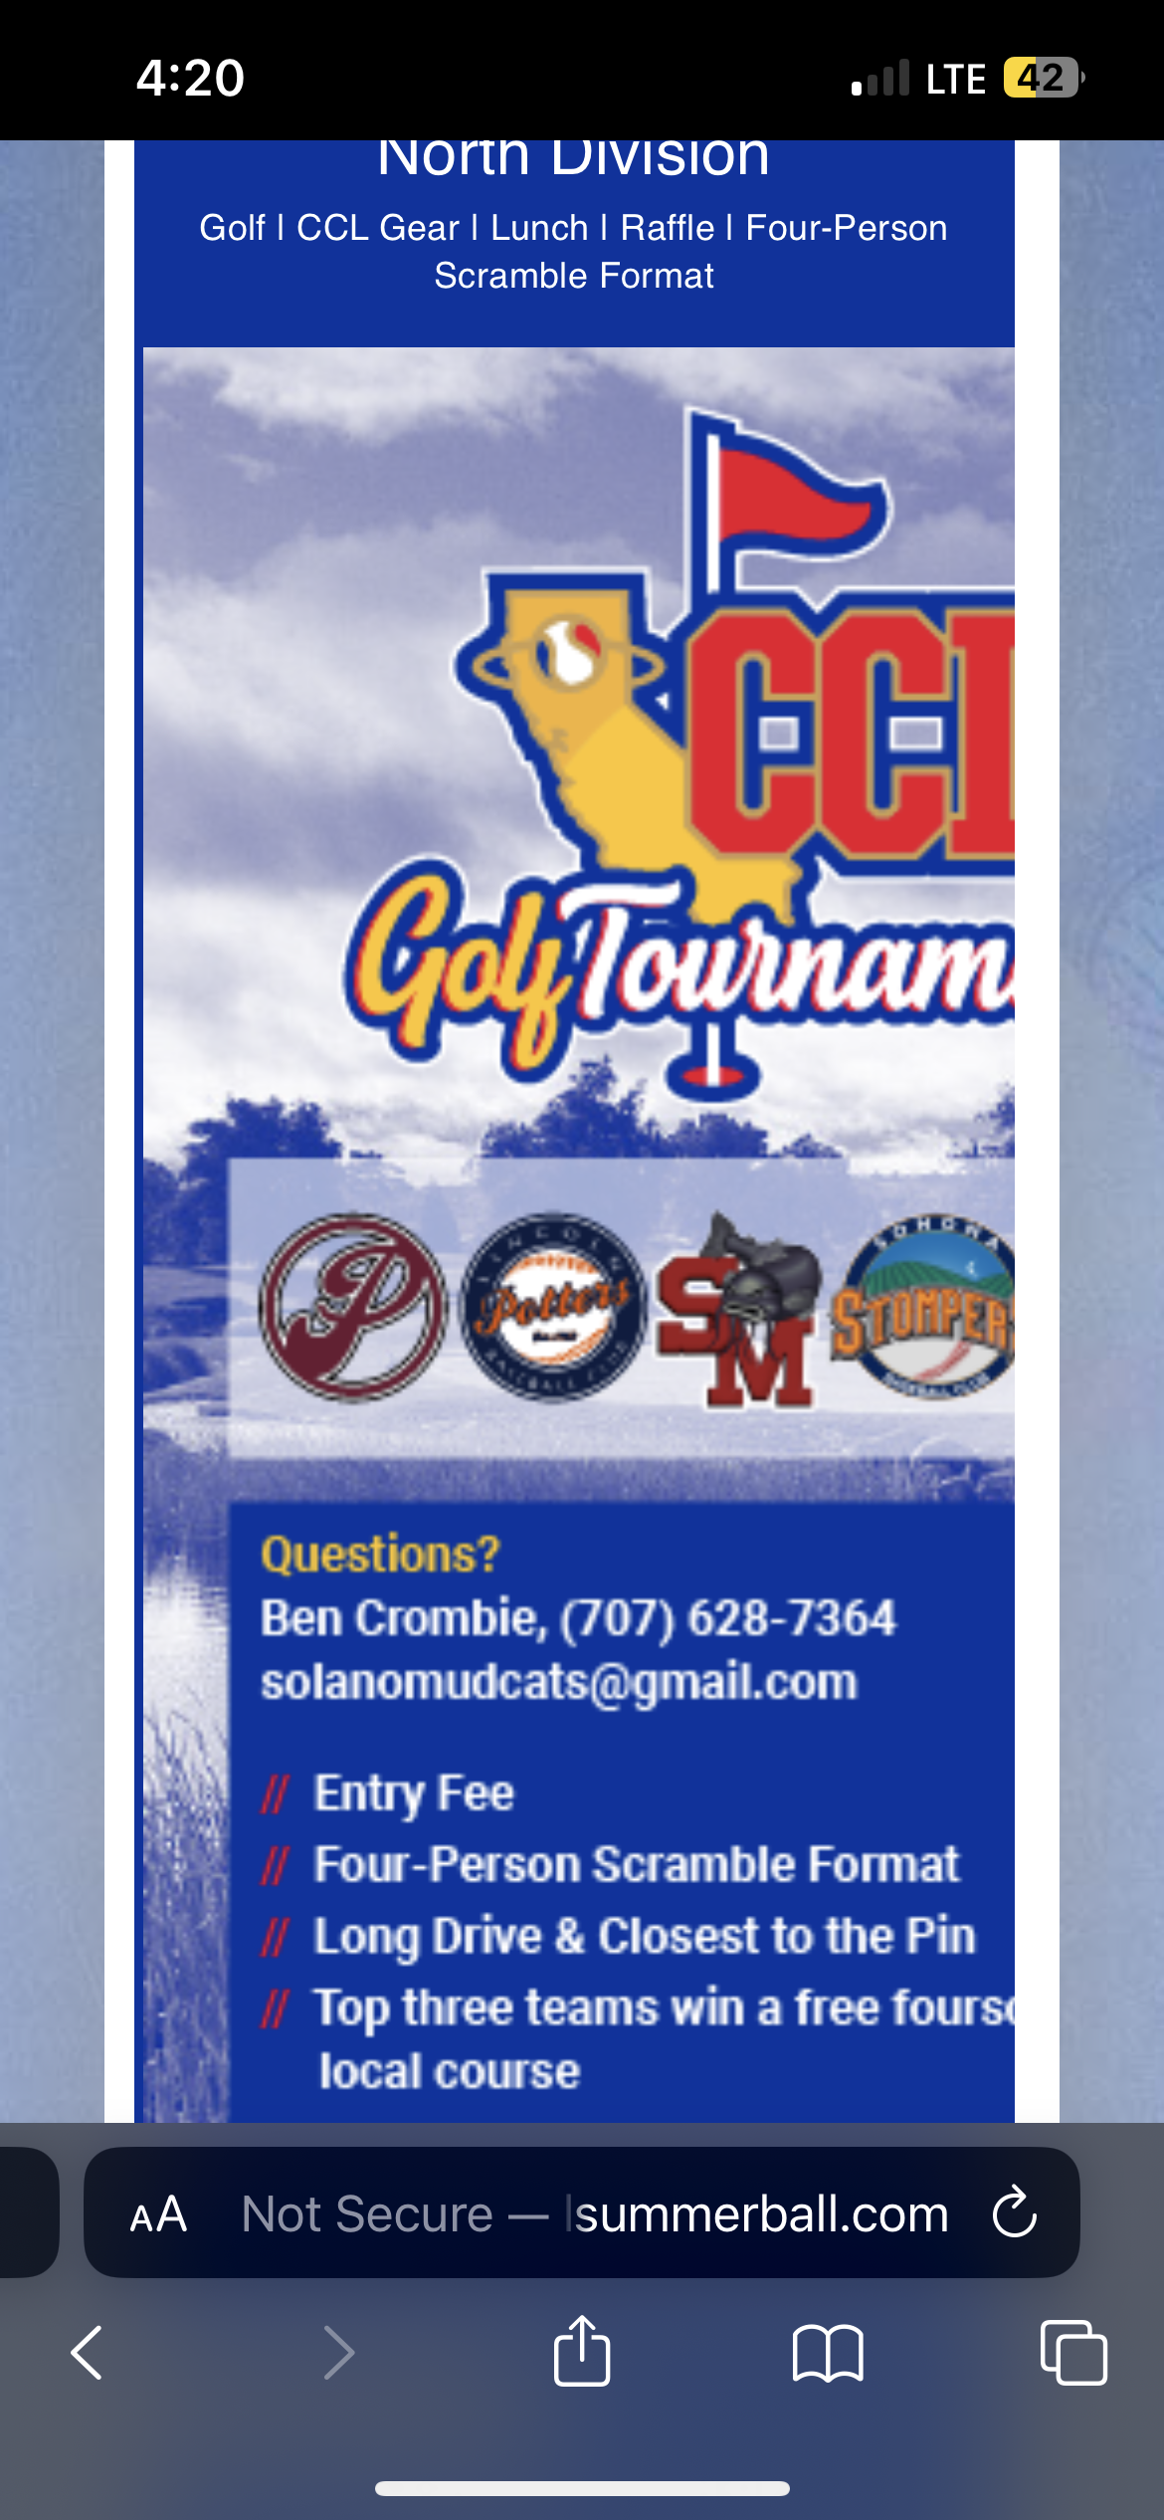
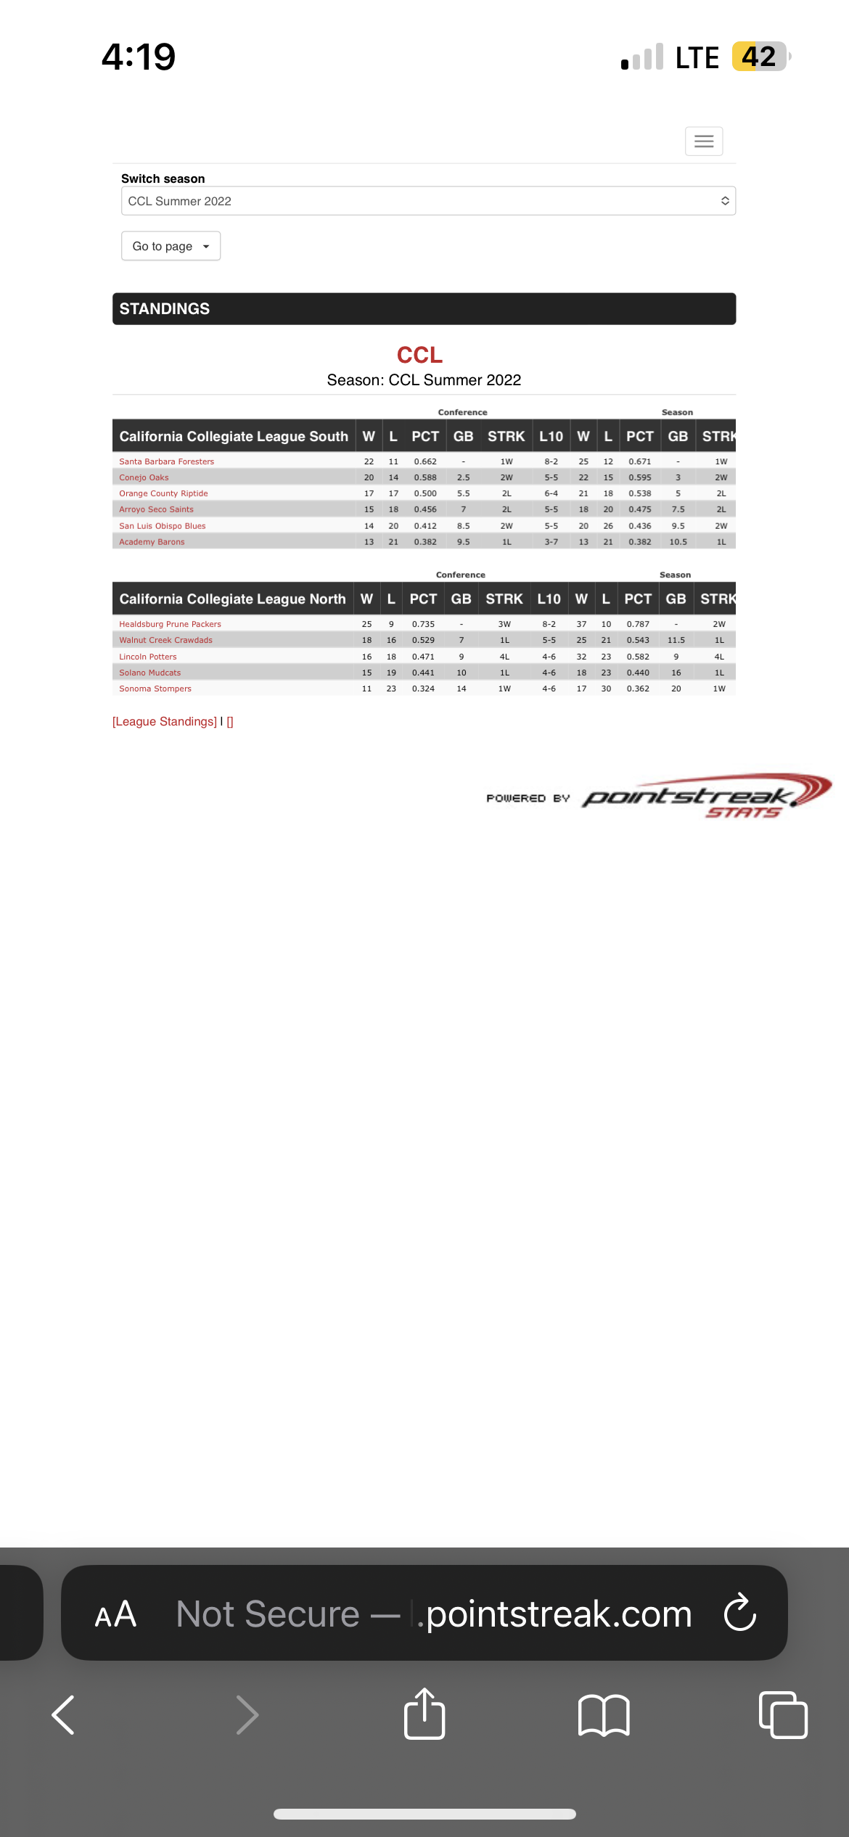
Mobile view problem 2
Top
Unnecessary gap on the bottom
Bottom
Same with the desktop view is this our website or pulled from Pointstreak.com

Slide 11
Timeline
HTTP/HTTPS, Load time
Improve the HTTP and HTTPS, remove unnecessary plugins and cache
Desktop view
Fix all the alignments and remove the gaps
Mobile view
Remove the gaps
Features
Check the all the features if everything is working fine
Extra features
Add extra features, check how much user friendly the website

Slide 12


Thank You
Peter Ramos
dchamp16@gmail.com

